Slide 1
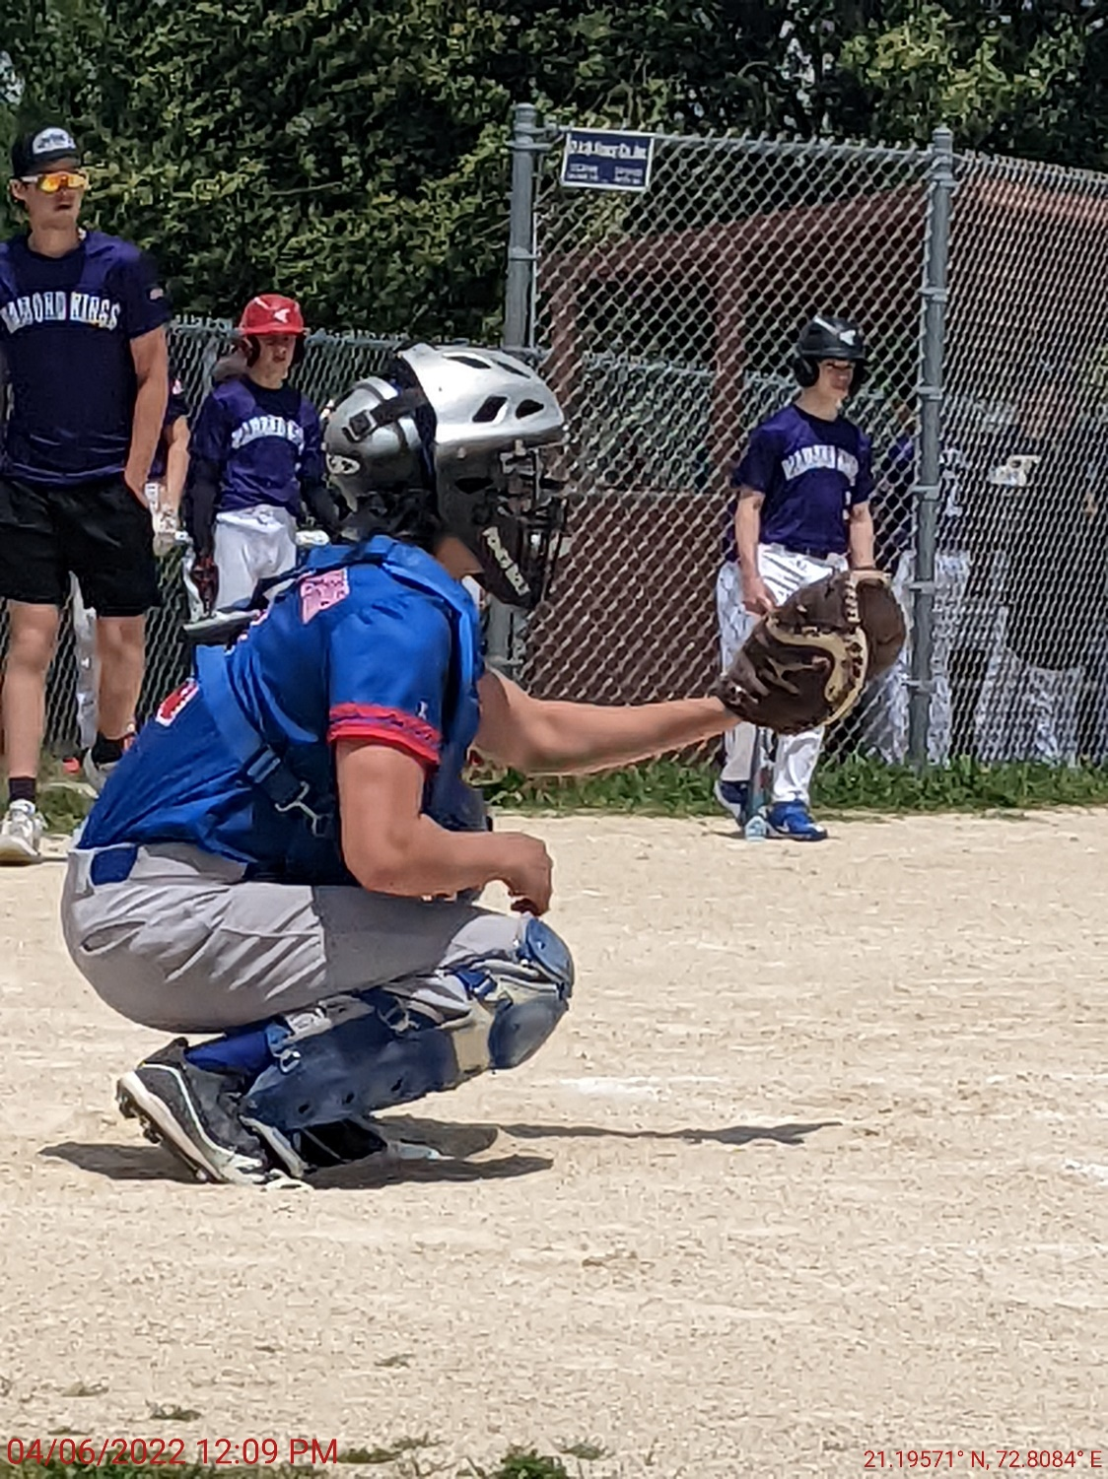

MBB Parents Meeting
Pony/Minor/Major
Leagues
March 30, 2026
WELCOME

Slide 2
Meeting Agenda
Overview
MBB Expectations
MBB Season
MBB Cancellations
Fundraising
Volunteering
MBB Rules of the Game Overview
Uniform & Gear
Team Colors
Questions

Slide 3
MBB
Board Members (Noel, Jeff, Cody, Don, Mark, Kimberlie, Paul, Lawerence and Russ)
Communication
  Facebook – Marion Boys Baseball
  MBB Website – www.marionbaseball.org
  Phone: 319-551-5583
  Email: marionboysbaseball@gmail.com
Practices at Starry and Hanna Park
Games at Starry Park

Slide 4
All League Expectations
Developing Player Skills and Knowledge of Baseball
Playing in Low-Pressure Environment – WINNING is Secondary
Modeling Good Sportsmanship
Encouraging Players to Play Different Positions
EVERYONE on the Team Bats on Game Day
Learn, Grow, and Have Fun!

Slide 5
MBB Season – All Leagues
Practices Begin Monday April 6th (Weather Permitting)
Spring Training Practices: Twice a Week Monday – Friday; 5pm, 6pm, or 7pm
Opening Day is Saturday May9th
Regular Season: 1 Practice and 1 to 2 Games per Week (July 4th Week – Off Week)
Practices: Mondays and Tuesdays (5pm, 6pm, or 7pm)
Batting Cage: Monday – Friday (5pm, 6pm, or 7pm)
Games: Wed, Thu, Fri, & Sat (5/30, 6/13, 6/27)
(Game Time Later in Presentation)
End Of Year Tournament – July 16-19; Single Elimination. All Teams in Tournament
MBB Night W/Kernels – Saturday July 11th

Slide 6
MBB Cancellation Policy
Rainouts – Every Opportunity will be made to reschedule Games later in the season.
Heat Advisory – Games and Practices as Scheduled – May be Delayed
Heat Warning – All MBB Activities are Cancelled.
Cancellation Notifications: MBB to Contact Coaches Through EMAIL for Cancellations/Delays
Updates to Social Media: MBB will update Website, and post on Instagram and Facebook.
Cancellation Decision Time: 3pm, or Earlier. On occasions, may be later. Every Opportunity will be made to get the game in.

Slide 7
Fundraising – Candy Bars
Very Important Event – Proceeds Directly Offsets Umpire Costs. Largest Expense for Our League
MBB Encourages Everyone to Sell a Box of Candy Bars
Candy Bar Nights: Scheduled Throughout the Month of April. (Notify by Social Media & Email)
Please Turn in Money once box(es) are Sold
MBB Venmo Account: @mbbMarion Be sure to put Player’s Name and Box # - DO NOT USE “Turn on for PURCHASES” MBB will get charged a FEE
Additional Candy Bars Will Be Available: MUST turn in Previous box(es) of Candy Bar Money before picking up new boxes of Candy Bars.

Slide 8
Fundraising – Candy Bars
Candy Bars: 40/Box
IF THE SEAL IS BROKEN, MBB CAN’T RETURN THE BOX. We cannot accept open boxes or partial boxes of candy bars. $80 Needs to be Turned In.
MBB makes $40 per box and if you would like to donate $40 instead, we would greatly appreciate it!
Our Goal is to Distribute All Candy Bar Boxes by Opening Day (May 9th). All Candy Bar Money Needs to be Turned In by May 30th.
Candy Bar Selling Incentives

Slide 9
Volunteers
Volunteers are what keeps MBB Going… MBB Board of Directors are 100% Volunteers
Parents and Family can be volunteers in many ways:
    Keep Score – Each team needs to keep score
    Run the Scoreboard
    Assist Coaches in Practices
    Retrieving Foul Balls – Kids, Bring back the foul balls to your umpire to get a red ticket. Turn in the red ticket for a treat at the Snack Bar.
    Send your comments to marionboysbaseball@gmail.com We love to hear your feedback on ways to improve our leagues.
THANK YOU to Our Volunteers! MBB is Powered by Volunteers.

Slide 10
MBB Rules Overview
MBB has 4 leagues:
  Pony: 7 – 9 Year Olds
  Minor: 10 – 12 Year Olds
  Major: 13 – 15 Year Olds
  Senior: 16 – 18 Year Olds
Home Team: Uses 3rd Base Dugout and is the Official Scorebook (Both Teams Keep Score for the game)
Sportsmanship: Zero tolerance for unsportsmanlike conduct by Players, Coaches, and Fans.
Weeknight Games: 5:30 Start Time.
  Pony: No New Inning after 1 hour and 30 minutes. Drop Dead Time: 7:30pm
  Minor/Major: No New Inning after 1 hour and 45 minutes. NO drop dead time.
Saturday Games: 9am, Noon, 3pm or 6pm Start Times.
  Pony: No new inning after 1hour and 30 minutes. Drop Dead Time is 2 hours
  Minor/Major: No new inning after 1 hour and 45 minutes. Drop Dead Time is 2 hours and 15 minutes.

Slide 11
MBB Rules Overview
5 Run Limit: 5 run limit per inning (each team) until Unlimited Runs Inning is called by the Umpire
10 Run/15 Run Rules: Game ends if either team is winning by: 15 Runs After 3rd Inning; 10 Runs After 4th Inning and on. Full Inning must be completed.
Unlimited Runs Inning: This is called before the game is approaching the time limit. When Unlimited Runs Inning is Called, should that inning finish before the time limit, a new Unlimited Runs Inning is called.
GAME SHALL NOT END BEFORE TIME LIMIT UNLESS 10 or 15 RUN RULE IS REACHED, or INCLEMENT WEATHER

Slide 12
MBB Rules Overview
If the time limit has not expired, the Umpire will call A New Unlimited Runs Inning.
California Rules: Runners on 2nd and 3rd with 1 out. Game Ends when Home Team takes the lead
California Rules is only applied to extra innings if time limit has not expired, unless it is the playoffs.
If Saturday Drop Dead Time is met during the inning, the score will revert to the previous completed inning.
Ties are OK

Slide 13
MBB Rules Overview
MBB Bat Policy:
  PONY / MINOR Bats:
    Drop -10 (length minus weight) Max drop.
    Barrel Size: 2 5/8 Inch ONLY,
    Max length: 33 inches,
    MUST HAVE USA Sticker.
    Wood Bats are ALLOWED.
  Major Bats:
    Drop -3 (Length minus Weight)
    Barrel Size: 2 5/8 Inch
    Max Length: 34 Inches
    MUST BE BBCOR
    Wood Bats are ALLOWED
Any Characteristics not mentioned above will make the bat ILLEGAL in MBB Games and Practices.

Slide 14
MBB Rules Overview
Clothing & Accessories
  No steel cleats
  No Shorts,
  No jewelry,
  Undershirt must match jersey,
  Sunglasses are Allowed: Exception: Pitcher and Catcher
  Prescription Sunglasses ONLY EXCEPTION
Free Substitution in All Leagues
Infield Fly Rule:
  Pony: Not Enforced
  Minor/Major: Enforced
Bunting:
  Pony: Not Allowed
  Minor/Major: Allowed

Slide 15
MBB Rules Overview
Baserunners & Baserunning:
  Leading Off:
    Pony/Minor – NO Leading Off
    Major – Leading Off is ALLOWED
  Orange Base:
    All leagues have an orange base next to 1st Base
    After ball is batted, the Batter must touch the Orange Base on any play at 1st base or running through 1st base without advancing.
    After ball is batted and extra bases involved, batter can touch the white base while advancing to 2nd base.

Slide 16
MBB Rules Overview
  Stealing Bases:
    Pony Base Stealing:
      Stealing 2nd Base and 3rd base is allowed when the pitched ball must hit the backstop before runner(s) can advance.
      Leaving Prematurely, the Umpire will wave off the stolen base and runner(s) need to return to the original base
    Minor Base Stealing: Stealing 2nd Base and 3rd Base is allowed when the pitched ball crosses Home Plate.
    Leaving Prematurely, the Umpire will wave off the stolen base and runner(s) need to return to original base.
    Major Base Stealing: All Bases are open to Stealing with no restrictions.

Slide 17
MBB Rules Overview
  Home Plate:
    PONY: No Advancement to Home Plate by Stealing, or the Catcher overthrows the Pitcher
      Home Plate is open when the ball is batted in fair territory, Catcher makes a throw back to other than the PITCHER, or any other defensive play before the play is over.
    Minor: Home Plate can be stolen after a pitched ball crosses the plate. If the Catcher blocks the pitch and the ball is within arms reach, HOME PLATE is CLOSED from Stealing, The play is over, and all runners must return to the base they are on
      If the Catcher overthrows the pitcher on a throwback, HOME PLATE IS OPEN.
      Once the Pitcher has the ball and is on the pitcher’s mound, Play is over, and runners must return to their bases.
    Major: No Restrictions to Home Plate
  Sliding:
    All Leagues: Runners are encouraged to slide into 2nd or 3rd on a close play. Must slide feet first at home plate. Subject to be called out if no slide into Home on close play. The Baserunner will be called out if the slide is headfirst into Home Plate

Slide 18
MBB Rules Overview
Pitching
  Mound Distance
    Pony: 40 Feet
    Minor: 48 Feet
    Major: 54 Feet
  Innings Pitched (IP):
  Pony/Minor:
    IP per Game: Each Player can Pitch a Maximum of 2 consecutive Innings
    IP per Rolling 7 Day Period: Each Player can Pitch a Maximum of 6 Innings
  Major:
    IP per Game: Each player can pitch a Maximum of 3 consecutive innings
    IP Per Rolling 7 Day Period: Each Player can Pitch a Maximum of 8 Innings
All Leagues: Pitchers may not re-enter game as a Pitcher once taken out. No Exceptions

Slide 19
Uniforms and Baseball Gear
Baseball Gear: MBB provides all Leagues the appropriate Equipment:
  Bats, Helmets, Catching Gear, and Baseballs
Players can use their own Baseball Gear within MBB guidelines for Equipment.
Uniform: Players and Coaches receive a Team Jersey and a Team Hat. Must be worn during games.
Players are responsible for:
  Baseball Glove
  Game and Practice Baseball Pants
  Belt and Socks
Pants, Belt and Socks are Team Color Specific
Sleeves/Undershirts – Any Solid Color EXCEPT White

Slide 20
Team Colors
Team Pants Belt Socks
Bombers Gray Navy Navy
Diamond Kings White Purple Purple
Fire White Red Red
Force White Yellow Yellow
Panthers White Royal Blue Royal Blue
River Bandits White Orange Orange
Thunder Gray Maroon Maroon
Hawks White Yellow Yellow
Play It Again Sports will have all MBB Colors and USA Bats. Ask for Marion Boys Baseball Discount.

Slide 21
Questions?
Thank you for your time!
DON’T FORGET YOUR CHOCOLATE.

