Slide 1
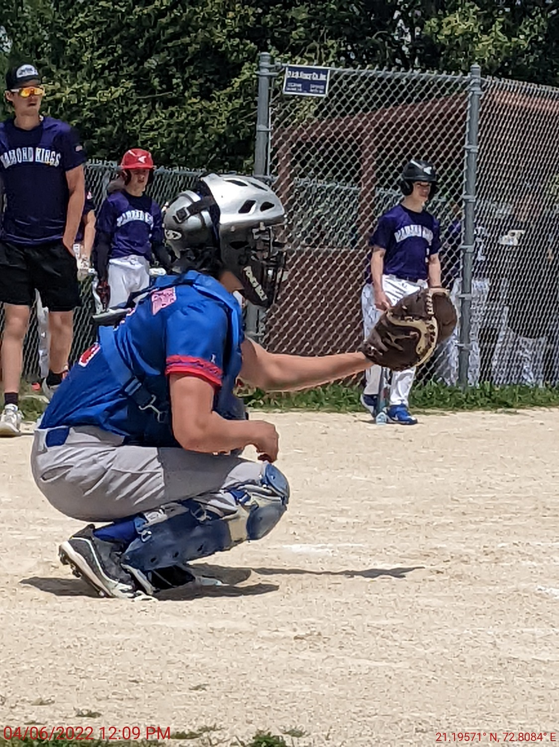
Major Parents Meeting
March 30, 2023

Slide 2
Outline
Overview
League Expectations
MBB Season
MBB Cancellations
Fundraising
Volunteering
2023 Rule Changes and Review
Uniform & Gear
Team Colors
Questions

Slide 3
Welcome
Board Members
Communication
Twitter – Type: Follow @marionbaseball
Facebook – Marion Boys Baseball
MBB Website – www.marionbaseball.org
Phone: 319-551-5583
Email: marionboysbaseball@gmail.com
Practices at Starry and Hanna Park
Games at Starry

Slide 4
League Expectations
Teaching the Game of Baseball
Playing in Low-Pressure Environment
Modeling Good Sportsmanship
Play Different Positions
EVERYONE on the Team Bats
Have Fun!

Slide 5
MBB Season
Practices Begin Monday April 3rd (Weather Permitting)
Practices: Twice a Week Prior to Opening Day. Monday – Friday; 5pm or 6:30pm
Opening Day is Saturday May 6th
13 Game Schedule – Includes 4 Saturdays
1 Practice, 1 Game (2 Games W/Saturday)
Practices Mon or Tue, Games Wed, Thu, or Fri
End Of Year Tournament – July 15-17; Single Elimination. All Teams in Tournament

Slide 6
MBB Cancellations
Rainouts – Every Opportunity will be made to reschedule Games later in the season.
Heat Advisory – Games and Practices as Scheduled – May be Delayed
Heat Warning – All MBB Activities are Cancelled.
Cancellation Notifications: Coaches will provide Messaging when MBB decides to cancel.
MBB will update Website, and post on Twitter and Facebook.
Decision to Cancel will try to be made by 3PM or Earlier. Every Opportunity will be made to get the game in.

Slide 7
Fundraising
Very Important – Proceeds Directly Offsets Umpire Costs. Largest Expense for Our League
MBB Encourages Everyone to Sell a Box of Candy Bars
Candy Bar Nights will be Scheduled Throughout the Month of April.
Announcements of Candy Bar Night will be Through Email, Facebook, Website, and Twitter.
Turn in Candy Bar Money as Box is SOLD
Venmo MBB Candy Bar Money: @mbbMarion
Additional Boxes of Candy Bars can be Picked up when Previous Candy Bar Money is Turned In.

Slide 8
Fundraising
IF THE SEAL IS BROKEN, MBB CAN’T RETURN THE BOX. We cannot accept open boxes or partial boxes of candy bars. $60 Needs to be Turned In.
MBB makes $30 per box and if you would like to donate $30 instead, we would greatly appreciate it!
Our Goal is to Distribute All Candy Bar Boxes by Opening Day (May 6th). All Candy Bar Money Needs to be Turned In by May 20th.

Slide 9
Snack Bar Volunteers
Each Team to Cover 2 Snack Bar Shifts
Each Shift Requires 2 Volunteers
Volunteers Must be 14 years Old or Older
Shifts are 2 ¼ Hours on Weekdays and 2 ½ Hours on Weekends
MBB Board Member will be Present and Responsible for Cooking on the Grill
Volunteer Duties: Taking & Fulfilling Orders, Prepare Walking Tacos and Super Nachos, Taking Payment and Restocking
Hot Dogs, Brats, and Chicken Sandwiches are Pre-Wrapped

Slide 10
Other Ways to Volunteer
Do the Scorebook
Volunteer to Run the Scoreboard
EOY Tournament Snack Bar Volunteer
Assist Coaches in Practice
THANK YOU to Our Volunteers! MBB is Powered by Volunteers.

Slide 11
2023 Rules and Changes
Major League is13 to15 Year-Olds
Home Team is 3rd Base Dugout and Official Scorebook (Both Teams Keep Score)
Sportsmanship – Zero tolerance for unsportsmanlike conduct
Weeknight Games: 5:30 Start Time. No new inning after 7:15.
Saturday Games: Noon, 3pm or 6pm Start Time. No new inning after 1hour and 45 minutes. Game Ends at 2 Hours and 15 Minutes.

Slide 12
2023 Rules and Changes
When Last Inning is Called, should that inning finish before the time limit, a new last inning is called.
New Last Inning (and every inning after) will be played by California Rules.
California Rules: Runners on 2nd and 3rd with 1 out. Game Ends when Home Team takes the lead
If Saturday Time Limit Expires during the inning, the score will revert to the previous completed inning.
Ties are OK

Slide 13
2023 Rules and Changes
Free Substitution
Bats
2 5/8 BBCOR Bats
Max Drop is -3
Wood Bats Allowed
Maximum Length is 34 Inches
NO OVERSIZED Bats Allowed
No steel cleats
No Shorts, no jewelry, undershirt must match jersey, sunglasses are allowed except pitcher and batter

Slide 14
2023 Rules and Changes
5 run limit per inning until final inning, then unlimited
15 Run Rule After 3rd Inning; 10 Run Rule After 4th Inning and on
Pitchers are allowed to pitch a maximum of 3 consecutive innings a game, 8 innings max per week (Rolling 7-day period).
Pitchers may not re-enter game as a Pitcher once taken out. No Exceptions

Slide 15
2023 Rules and Changes
Balks will be enforced
Infield fly rule will be used
No Restrictions on Stealing, including Home
Bunting is Allowed
Baserunners must touch the orange base on a close play.
Baserunners must slide feet first into home if there is a play at the plate

Slide 16
Uniforms and Baseball Gear
MBB Provides Hat and Jersey to all players and coaches
MBB Provides each team with Bats, Helmets, Baseballs, and Catching Gear
Players can use their own Bat and Helmet if preferred
Players are responsible for Baseball Glove, Pants, Belt, and Socks. Colors are specific to each team.

Slide 17
Team Colors
Team Pants Belt Socks
Bombers Gray Navy Navy
Diamond Kings White Purple Purple
Fire White Red Red
Force White Yellow Yellow
Panthers White Royal Blue Royal Blue
River Bandits White Orange Orange
Thunder Gray Maroon Maroon
Hawks White Yellow Yellow
Wolves White Light Blue Light Blue

Slide 18
Questions
Thank you for your time!

